Slide 1
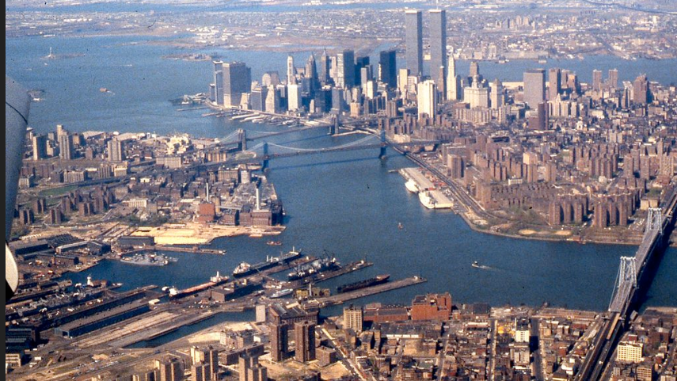
NY Harbor Water Quality Visualization
Team Composition:
Sarah
Pournima
Gargi
Nitin

Slide 2
The purpose of this project is to render data and visualizations relating to various elements determining quality of harbor water in New York, to users. The data includes findings of the DEP(NY). The output of this project is the culmination of following skills:
• Data Warehousing: Data Extraction, Transformation, and Loading
• Data Wrangling
• Data Visualization
* Apart from demonstrating technical abilities , the team created an interactive dashboard where in users can view the changing water quality without getting into nitty gritty of data, if they want they can look into raw data, as well.
Rationale and Motivation

Slide 3
Data Source
Dataset | Source
NYC Water Quality | NYC Open Data (API)

Slide 4
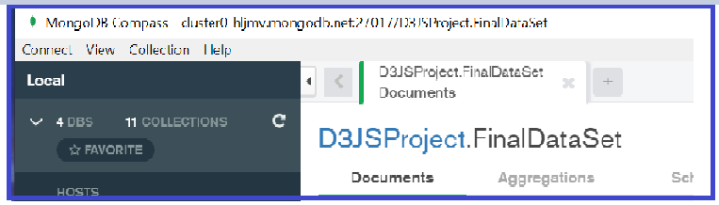
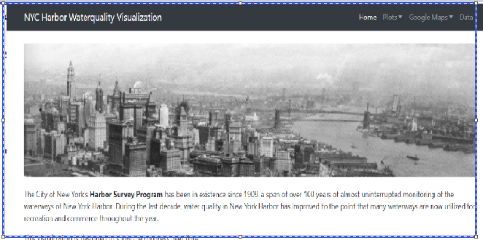
Design Document
API Call to NYC Open Data and Data wrangling with help of Python
Technology Stack
HTML
CSS
Java Script
Mongo DB (Cloud)
GUI – Mongo Compass & Studio 3
Python & Flask
NYC Open Data for Water Quality

Slide 5
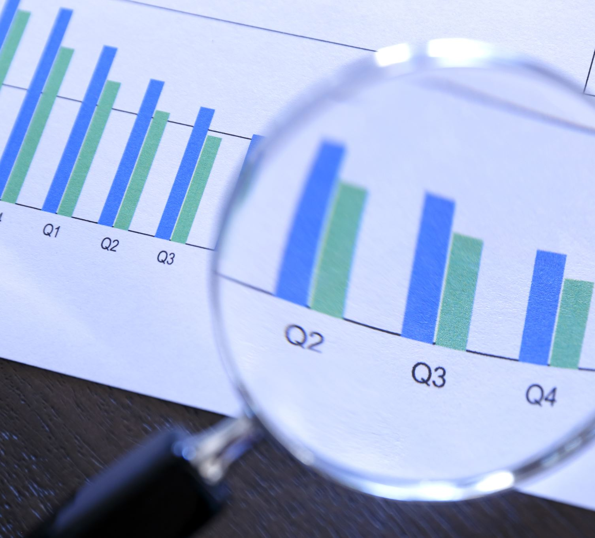
Results

Slide 6
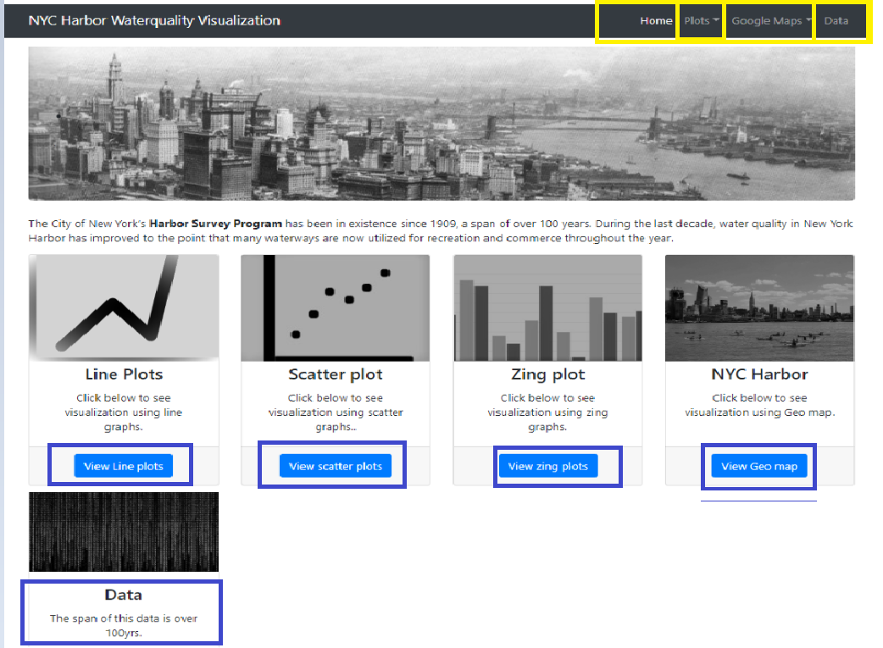
Home Screen (UI)

Slide 7
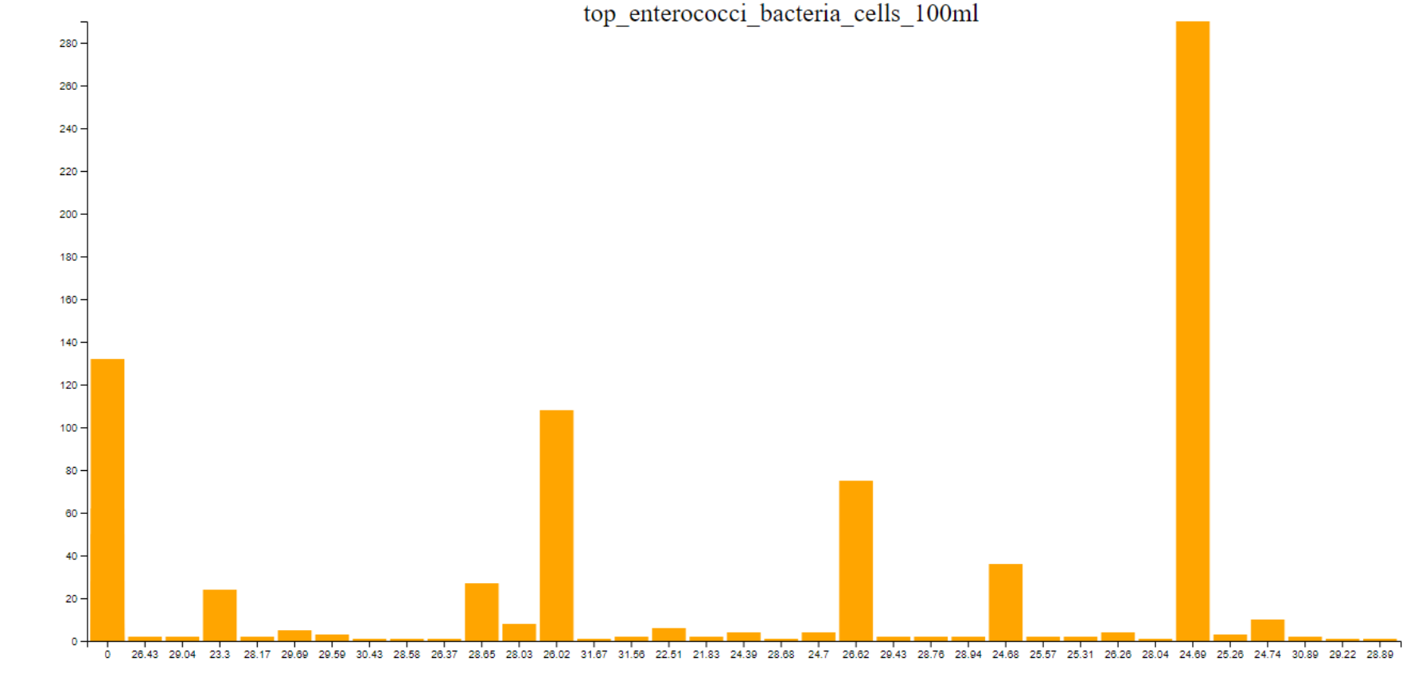
Simple Bar Chart

Slide 8
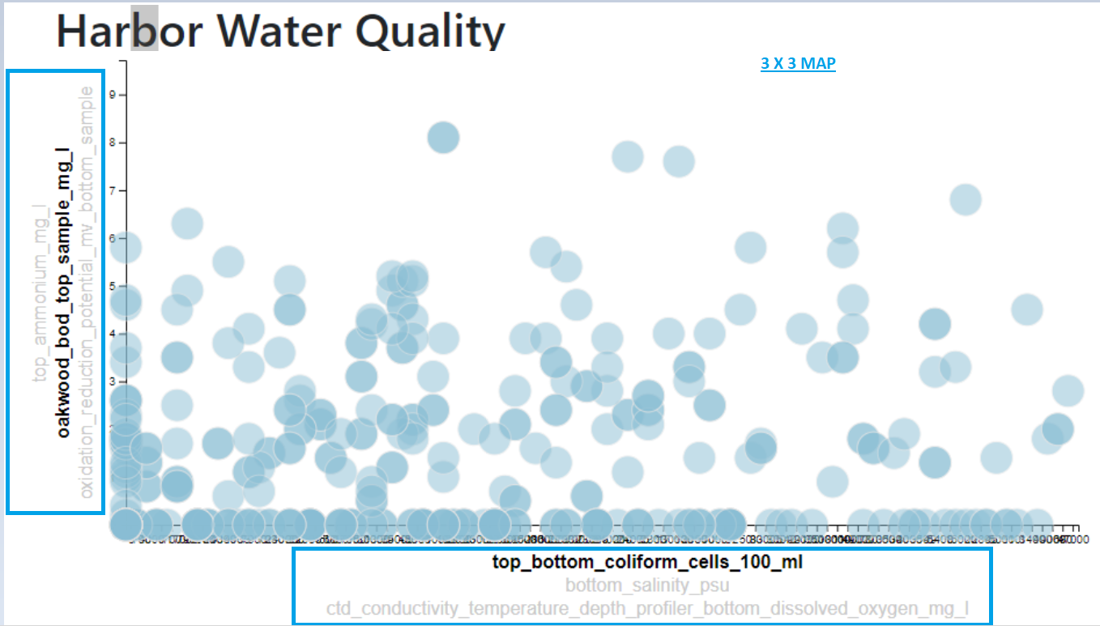
3 x 3 Plotly Interactive Vizualition

Slide 9
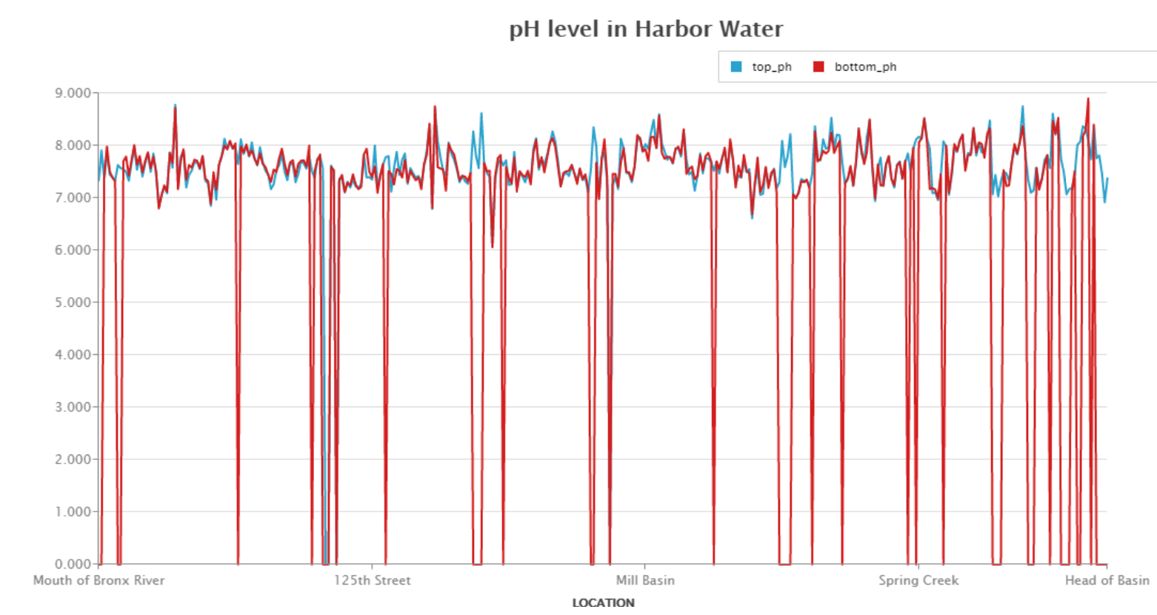
Zing Chart

Slide 10
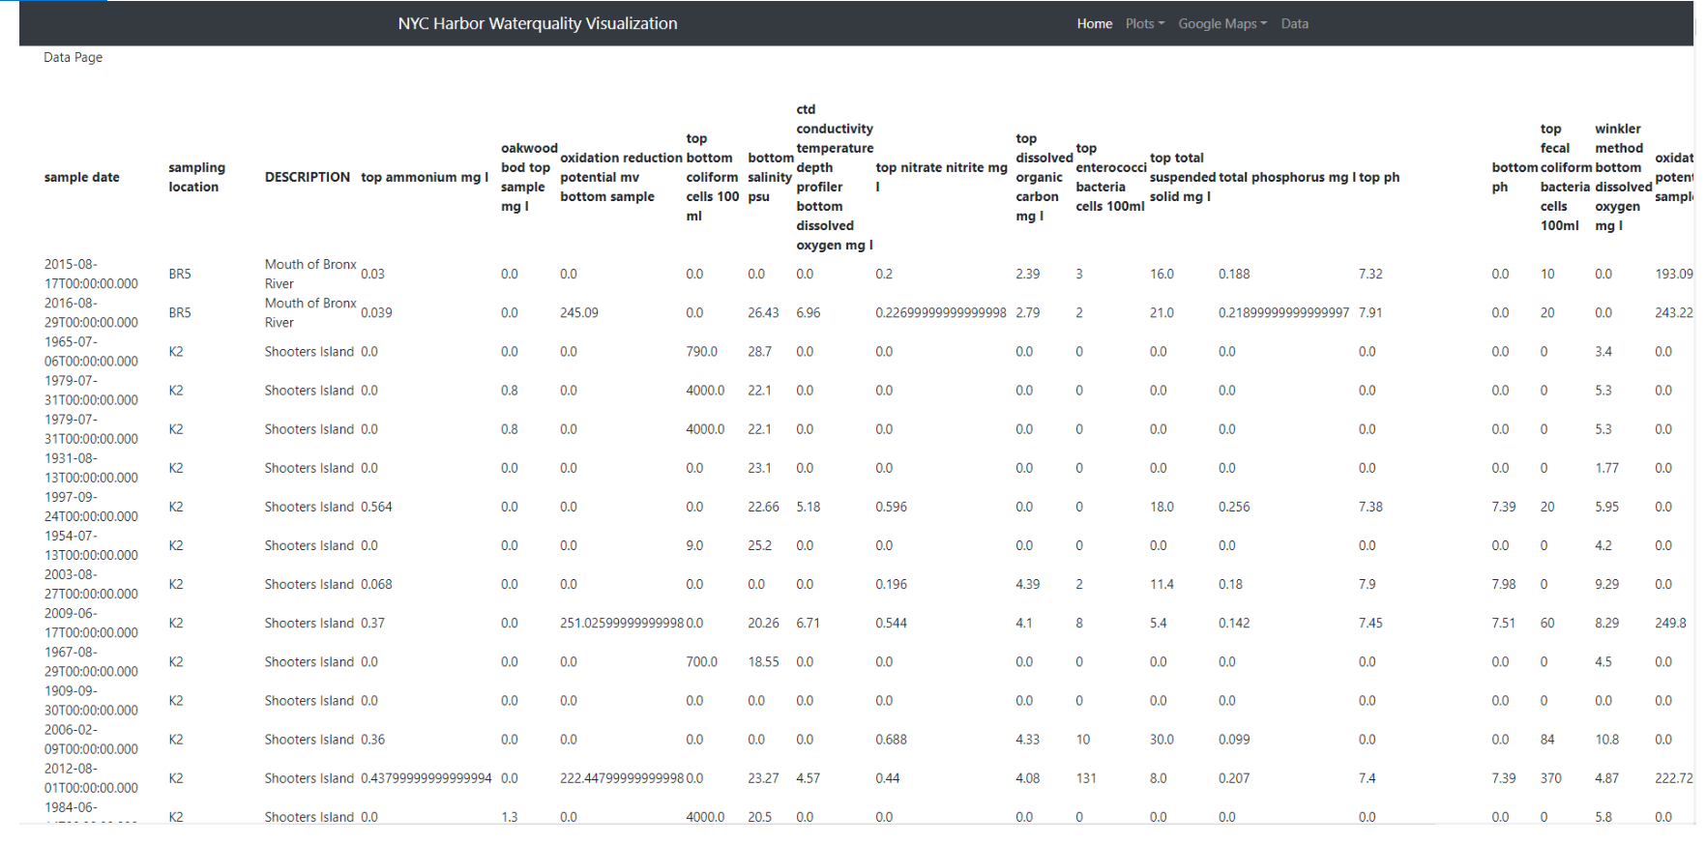
Raw Data from HTML Page (Source Mongo Cloud)

Slide 11
Thank you

Slide 12
?

